Slide 1

Data structures using C
Module 4 - Lecture VII
Trees
Prepared By
Ms. Smriti Sehgal

Slide 2
B-Trees
B-Tree is a self-balancing search tree.
B-Tree is a tree in which a node contains more than one value (key) and more than two children.
The number of keys in a node and number of children for a node depends on the order of B-Tree. Every B-Tree has an order.

Slide 3
“m” is the total number of elements in the B-tree.
Properties of B-Tree:
Property #1 - All leaf nodes must be at same level.
Property #2 - All nodes except root must have at least [m/2]-1 keys and maximum of m-1 keys.
Property #3 - All non leaf nodes except root (i.e. all internal nodes) must have at least m/2 children.
Property #4 - If the root node is a non leaf node, then it must have atleast 2 children.
Property #5 - A non leaf node with n-1 keys must have n number of children.
Property #6 - All the key values in a node must be in Ascending Order.

Slide 4
B-Tree with order 5
(non-root) | Min | max
Keys | ceil(m/2)-1 | m-1
Children | Ceil(m/2) | m
Eg. | Min | max
Keys | 2 | 4
Children | 3 | 5

Slide 5
Operations on B-Tree
Searching
Insertion
Deletion

Slide 6
Searching
Step 1 - Read the search element from the user.
Step 2 - Compare the search element with first key value of root node in the tree.
Step 3 - If both are matched, then display "Given node is found!!!" and terminate the function
Step 4 - If both are not matched, then check whether search element is smaller or larger than that key value.
Step 5 - If search element is smaller, then continue the search process in left subtree.
Step 6 - If search element is larger, then compare the search element with next key value in the same node and repeat steps 3, 4, 5 and 6 until we find the exact match or until the search element is compared with last key value in the leaf node.
Step 7 - If the last key value in the leaf node is also not matched then display "Element is not found" and terminate the function.

Slide 7
Searching
Searching 120 in the given B-Tree

Slide 9
Insertion
Step 1 - Check whether tree is Empty.
Step 2 - If tree is Empty, then create a new node with new key value and insert it into the tree as a root node.
Step 3 - If tree is Not Empty, then find the suitable leaf node to which the new key value is added using Binary Search Tree logic.
Step 4 - If that leaf node has empty position, add the new key value to that leaf node in ascending order of key value within the node.
Step 5 - If that leaf node is already full, split that leaf node by sending middle value to its parent node. Repeat the same until the sending value is fixed into a node.
Step 6 - If the splitting is performed at root node then the middle value becomes new root node for the tree and the height of the tree is increased by one.

Slide 10
Eg.

Slide 14
Exercise
Construct a B-tree with order 3 for the following set of values
(2, 3, 5, 7, 11, 17, 19, 23, 29, 31)
Assume that the tree is initially empty and values are inserted in given order.
Eg. | Min | max
Keys | 1 | 2
Children | 2 | 3

Slide 15
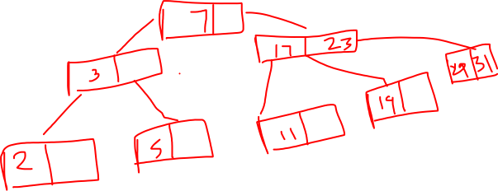
(2, 3, 5, 7, 11, 17, 19, 23, 29, 31)

Slide 16


